Slide 1

Unit - 7 Extended or Enhanced ER Model
Dr. Asif Sohail University of the Punjab
Department of Information Technology, FCIT

Slide 2
Extended or Enhanced ER Model
It extends original E-R model with new modeling constructs.
Used to cope with the dynamic and complex business environment.
It uses the representations for supertypes and subtypes.

Slide 3
E-R Model
Super Types, Subtypes - Example
EMPLOYEE TYPE | ATTRIBUTES
1. Hourly | ENo, EName, Address, Hire_Date, Hourly_Rate
2. Salaried | ENo, EName, Address, Hire_Date, Salary
3. Contract | ENo, EName, Address, Hire_Date, Rate
We have three choices for ER diagram:
Define a single entity type Employee with all the possible attributes in it.
Define a separate entity type for each employee type.
Define a supertype with all the common attributes and introduce its subtypes having only the applicable attributes.
ER Diagram

Slide 4
E-R Model
Super Types, Subtypes
A Super type is a generic entity type that is subdivided into subtypes.
A Subtype is a subset of a super type that shares the common attributes of the super type plus it has some of its own attributes that distinguish it from other subtypes.
The super type and subtypes employ the concept of Generalization and Categorization.
Generalization is the concept that some entities are subtypes of other more general entities. E.g. Bird, Vehicle etc.
Categorization is the concept that an entity comes in various subtypes.
Super type & Subtype representation is used to represent the entities that are very much similar.
Attribute Inheritance:
Subtype entities inherit values of all attributes of the supertype
Subtype entities inherit their primary key from their supertype
An instance of a subtype is also an instance of the supertype

Slide 5
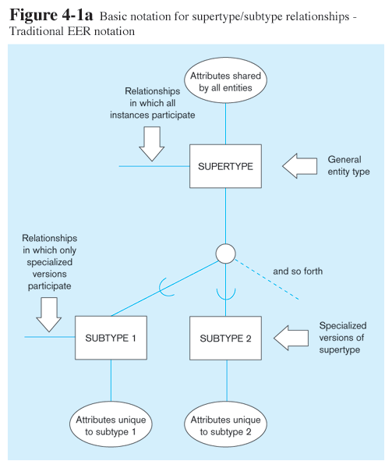

Slide 6
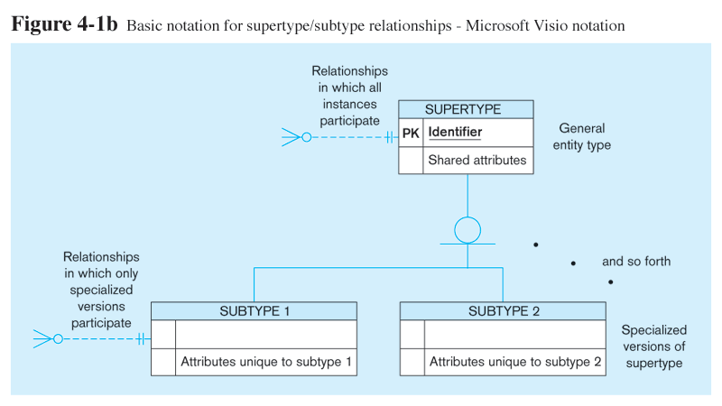
Basic Notations for Super Type/Subtype
Different modeling tools may have different notation for the same modeling constructs

Slide 7
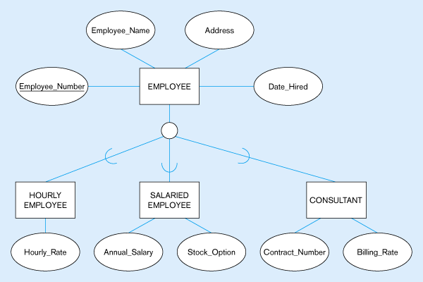
Figure 4-2 – Employee supertype with three subtypes
All employee subtypes will have emp nbr, name, address, and date-hired
Each employee subtype will also have its own attributes

Slide 8
Faculty supertype with two subtypes

Slide 9
E-R Model
Super Types, Subtypes
The relationship between each subtype and its super type is called ISA relationship.
The relationship is read from the subtype to the super type.
The cardinality of the relationship from subtype to super type is always mandatory one and from super type to subtype is optionally one. Henceforth, cardinality may be omitted in diagram.

Slide 10
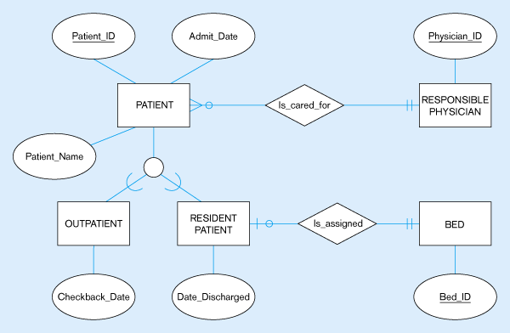
Supertype/subtype relationships in a hospital
Both outpatients and resident patients are cared for by a responsible physician
Only resident patients are assigned to a bed

Slide 11
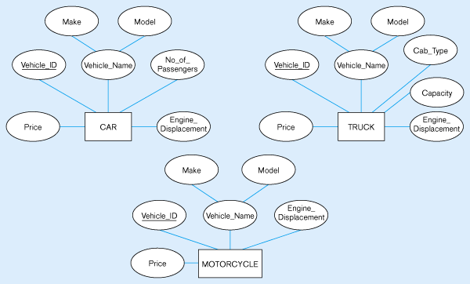
Example of generalization
Three entity types: CAR, TRUCK, and MOTORCYCLE
All these types of vehicles have common attributes

Slide 12
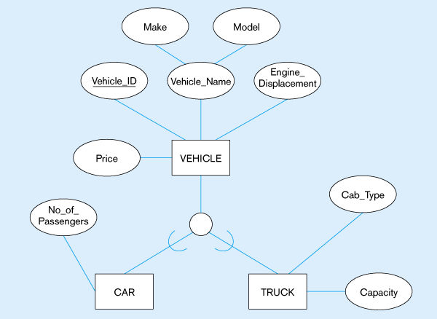
Generalization to VEHICLE supertype
So we put the shared attributes in a supertype
Note: no subtype for motorcycle, since it has no unique attributes

Slide 13
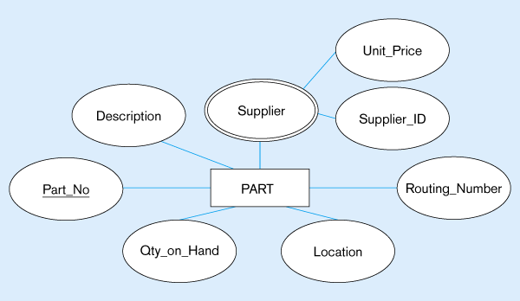
Example of specialization
Entity type PART
Applies only to purchased parts
Only applies to manufactured parts

Slide 14
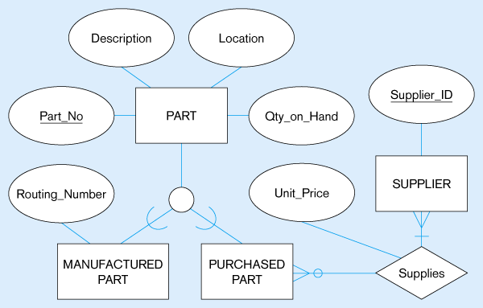
Specialization to MANUFACTURED PART and PURCHASED PART
Created 2 subtypes
Note: multivalued attribute was replaced by a relationship to another entity

Slide 15
Generalization Constraints
1. Completeness Constraint
All the subtypes have been defined and there can’t be any further subtypes.
Exhaustive / Non-Exhaustive Subtypes
2. Disjointness Constraint
Exclusive / Non-Exclusive Subtypes
Criterion | Ans? | Rule / Constraint
Each instance of a supertype must be a member of at least one subtype? | Yes | Total Specialization
 | No | Partial Specialization
Criterion | Ans? | Rule / Constraint
Each instance of a super type is categorized as exactly one subtype? | Yes | Disjoint (d)
 | No | Overlap (o)

Slide 16
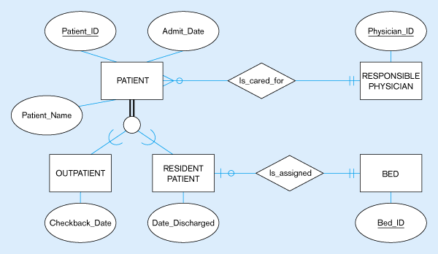
Total Specialization Rule
A patient must be either an outpatient or a resident patient

Slide 17
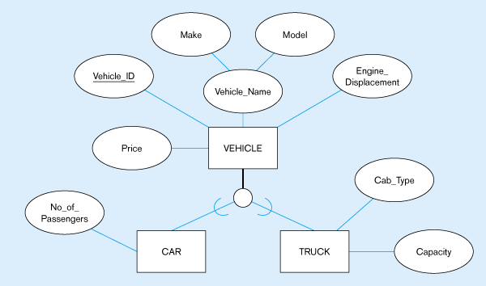
Partial Specialization Rule
A vehicle could be a car, a truck, or neither

Slide 18
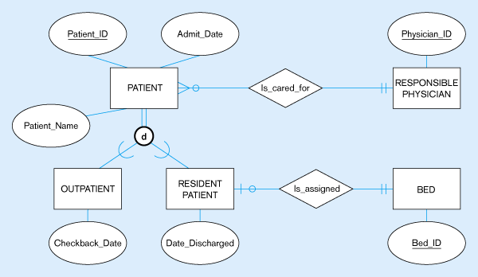
Disjoint Rule
A patient can either be outpatient or resident, but not both

Slide 19
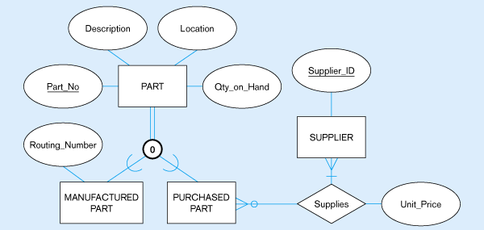
Overlap Rule
A part may be both purchased and manufactured

Slide 20
Subtype Discriminators
An attribute of the super type whose values determine the target subtype(s)
Disjoint – a simple attribute with alternative values to indicate the possible subtypes
Overlapping – a composite attribute whose subparts pertain to different subtypes. Each subpart contains a Boolean value to indicate whether or not the instance belongs to the associated subtype

Slide 21
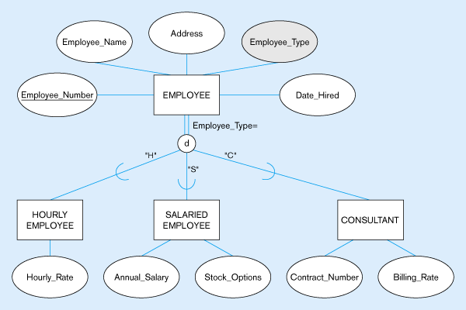
Subtype Discriminator (disjoint Rule)
A simple attribute with different possible values indicating the subtype

Slide 22
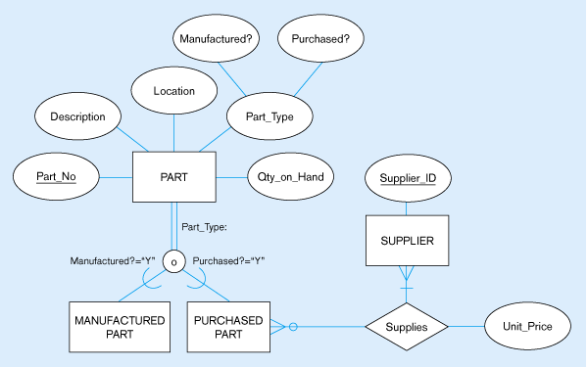
Subtype discriminator (Overlap Rule)
A composite attribute with sub-attributes indicating “yes” or “no” to determine whether it is of each subtype

Slide 23
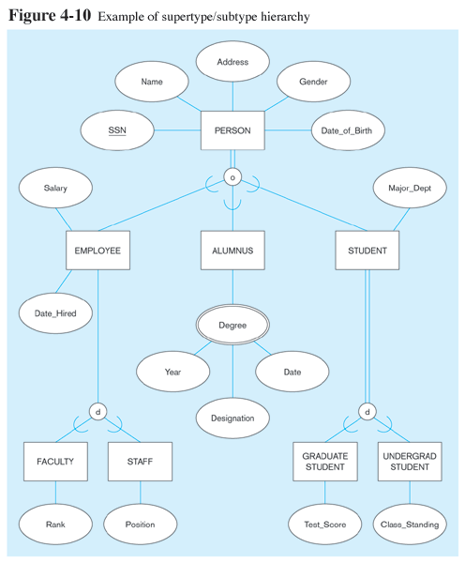

Slide 24
Specialization Hierarchy (Tree Structure or Strict Hierarchy)

Slide 25
Specialization Lattice
Shared Subset
An entity set that is a subset of two or more supersets.

Slide 26
UNION
A subtype is related to any one of the supertypes.

Slide 28
Entity Clustering
Entity clustering is a useful way to present a data model a large and complex systems involving hundreds of entities.
An entity cluster is a virtual entity type formed by combining multiple related entities.
Referring to the examples discussed, the entities related employee, patient, part can be clustered together.
The cardinalities of the relationships of the clustered entities with the other entities remain the same.

Slide 29
Reading Material
Database Systems – Design, Implementation and Management: Carlos Coronel, Steven Morris (13th Ed.)
Modern Database Management: Jeffery. A. Hoffer (12th Ed.)
Database Systems: Thomas M. Connolly (6th Ed.)
Fundamentals of Database Systems: Elmasri (7th Ed.)
Database System Concepts: Abraham Silberschatz (7th Ed.)
Databases Illuminated: Catherine M. Ricardo (3rd Ed.)
Book | Section(s) / Chapter
A | Sections 5.1, 5.2
B | Pages 114 to 134
C | Sections 12.1, 12.3
D | Chapter 4
E | Section 6.8
F | 3.9 to 3.12

Slide 30
Thank you for your attention.
Dr. Asif Sohail
Assistant Professor
Department of Information Technology,
Faculty of Computing and Information Technology (FCIT)
University of the Punjab, Lahore, Pakistan
Tel: +92-(0)42-111-923-923 Ext. 154
E-mail: asif@pucit.edu.pk

